Slide 1
View the slides to gain a better understanding of what I expect from you when completing the Literature Circle Role Sheets.
SPECIAL NOTE
Follow the instructions on the role sheet! The examples provided may not contain all of the required information (like pg. #s or paragraph #s) that the role sheet asks you to write down. You are still required to provide this information.
*The purpose of the example slides is to show you how to extend your responses and what kinds of questions you should be creating.
There is a slide dedicated to each role for you to view. Remember that these are examples, not for you to copy, but to show the effort that is being put forth in completing the assigned role. Grading will be determined on the effort you are demonstrating.

Slide 2
EXAMPLES OF WELL DONE ROLE SHEETS!!

Slide 3
Literature Circle Roles - Discussion Director (Create a minimum of 3 questions and then answer)
Yes. Both try to get Mr. Bingley’s attention in order to gain his interest in marrying them. They both want wealthy husband and share excitement with their mother that such a wealthy man lives nearby.
This suggests that social class is important to the wealthy and that it’s taken into consideration when creating friendship and romantic relationships. Social class defines everybody and the amount of wealth someone has is a huge factor.
The holy objects, including the crucifix, the garlic, the wild rose, and the mountain are all old remedies against vampires. People know that he is from London, and he is not a local, so they are trying to keep him safe.
Do you think Elizabeth and Jane would agree with the opening sentence of the book?
Most characters are introduced with explanation of their fortune and their family/place they live. What does this suggest about the importance of money and social status?
What is the significance behind the holy objects, and why do you think so?

Slide 4
Literature Circle Roles – Summarizer (example of a good summary over pages read)
Chapters 1-6 of Pride and Prejudice by Jane Austen present the characters and plot of the story with the opening sentence, “It is a truth universally acknowledged that a single man in possession of a good fortune, must be in want of a wife.” Jane Austen introduces the Bennet family with five unmarried daughters. Knowing that the father is having financial problems, the mother, Mrs. Bennet, saw benefit in one of her daughter’s marrying the rich neighbor, Mr. Bingley. The Bennets showed up at the ball where Mr. Bingley is also there. Soon, Mr. Bingley danced with Jane Bennet twice and began feeling for her, making her family very thrilled. The book later brought on Mr. Bingley’s friend, Mr. Darcy, into the plot and expresses how his character is disliked by mostly everyone. These first chapters are important because it gives the reader the plot of the story and helps them recognize the characters in the book.

Slide 5
Literature Circle Roles – Connector (make a minumum of 2 connections and create the questions to ask that go with the connections)
What books or stories might you compare this to?
What is the most interesting or important connection that comes to mind?
In Dracula by Bram Stoker, he mentions, “I was not able to light on any map or work giving the exact locality of the Castle Dracula…” (pg. 2) This reminded me of the movie Journey to the Center of the Earth when they had the name of an island where the protagonist was but they couldn’t find it on a map.
On page 5 the author mentions how during the 17th century, 13,000 people died because of war and disease. This reminded me of how the Black Plague killed over ⅓ of Europe’s population during the 16th century and how the hundred-year war also took many lives during this time.

Slide 6
Literature Circle Roles – Illuminator (pick a minimum of 2 passages to discuss)
“Joe’s station and influence were something feebler (if possible) when there was company than when there was none. But he always aided and comforted me when he could, in some way of his own, and he always did so at dinner-time by giving me gravy, if there were any.” Ch 4. Pg 19 Great Expectations by Charles Dickens
“When the Count saw my face, his eyes blazed with a sort of demonaic fury, and he suddenly made a grab at my throat. I drew away, and his hand touched the string of beads which held the crucifix. It made an instant change in him, for the fury passed so quickly that I could hardly believe that it was ever there.” Ch. 2, pg 28 Dracula by Bram Stoker
There is an evident bond between Joe and narrator, Pip. As such here and the repetition of action by Joe to comfort Pip after the continuous onslaught of indirect and direct insults to Pip by the company at dinner. It was funny to me to see Joe keep trying, heh.
This quote is about when Jonathan cut himself and Dracula tried to attack him and drink his blood. The crucifix, given to him by an old woman in town saved his life. This quote is important because it highlights the theme of “Good vs. Evil.” The crucifix (good) overpowers Dracula (evil). This could also foreshadow the ending of the book with good eventually beating evil.

Slide 7
Literature Circle Roles - Word Watcher (pick a minimum of 3 words to discuss)
“Partickler” Ch. 1, pg. 6, 3rd paragraph Great Expectations
Scrupulous - pg. 5 paragraph 1
This word is interesting because it used in a dialect. The word is actually “particular” but the author writes the word the way the common-person would pronounce, a little cruder.
Definition: having ethical or moral principles. I found the definition of this word because it was describing how he wants his daughters to go about life and dating/marriage. This seems to be an important part of this book.

Slide 8
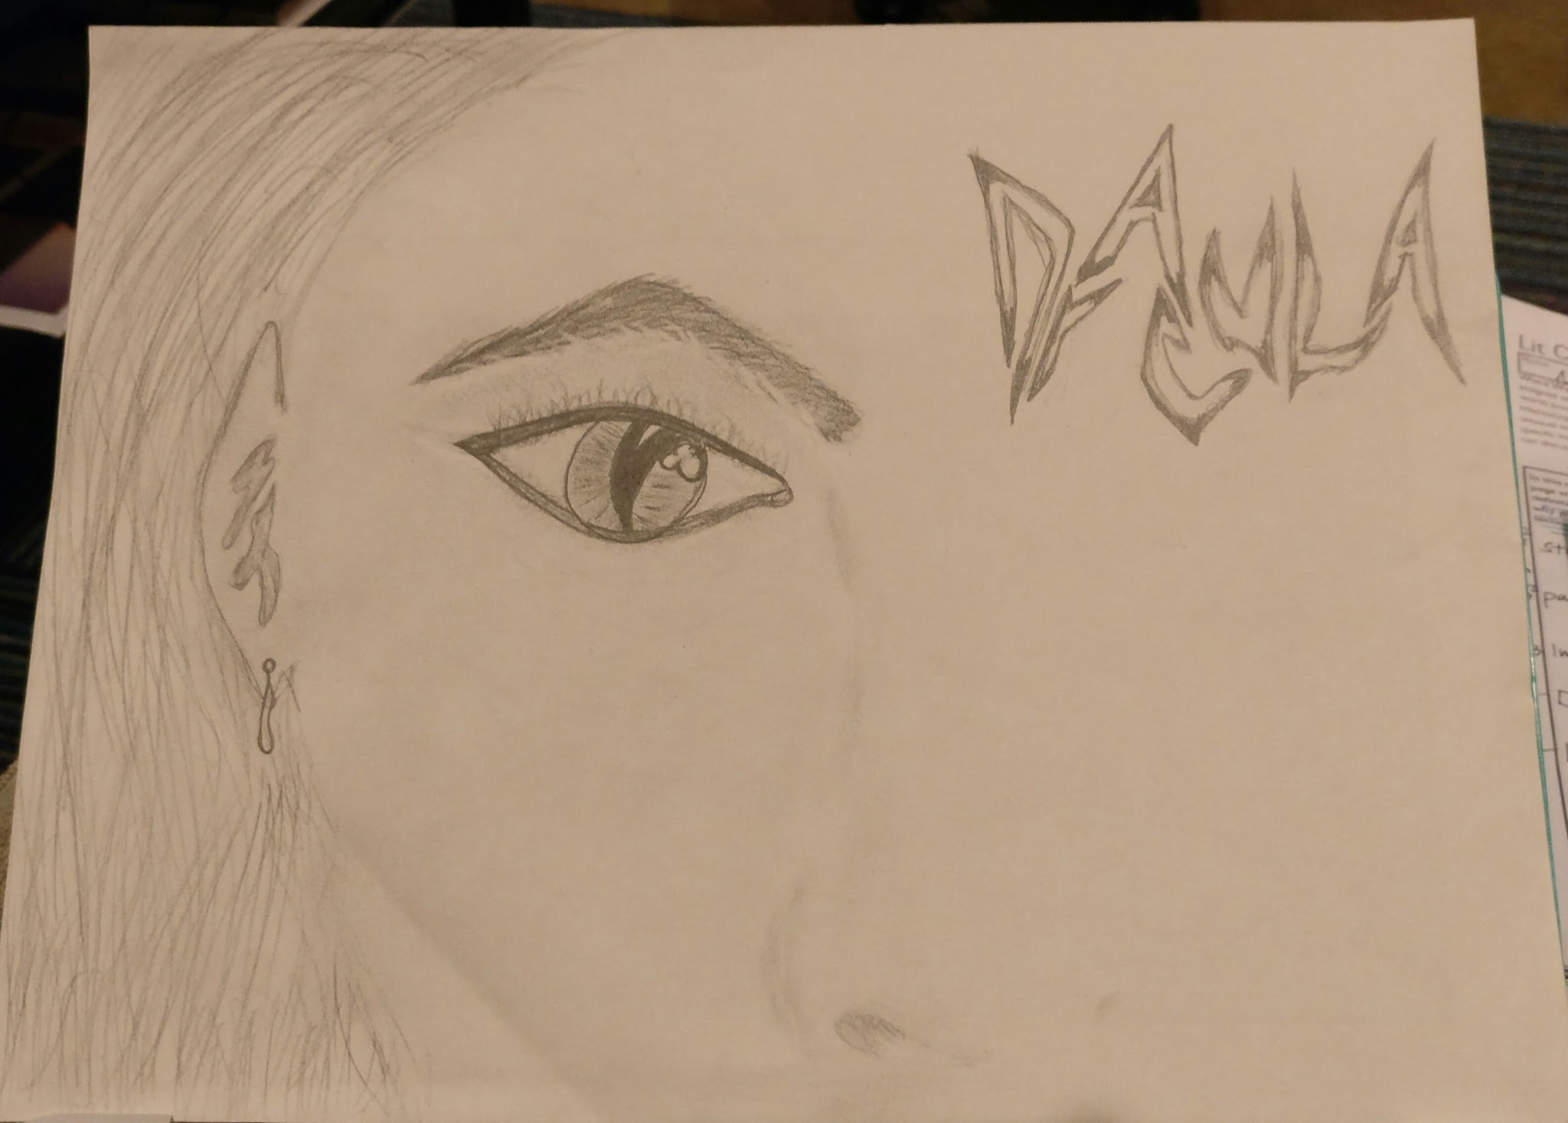
Literature Circle Roles – Illustrator (label your drawing and tell us why you picked that scene to illustrate. Go into detail with your reasons why!) (Follow the instructions on the role sheet)
“Jonathan is outside of Dracula’s castle when he is welcomed by the Count himself. Count is a tall, clean-shaven, old man with a white mustache. He has ice cold, strong hands, pointed ears, sharp teeth, and pale skin…”

