Slide 1
Agenda: Block 5 (Jan 13/17)
Mini-Lesson: Narrator and Point of View
The True Story of the Three Little Pigs
Review Jane Eyre excerpt
Read and discuss Oliver Twist excerpt
Lit Circle Time - Role #3
30 minutes reading (quiet time!)

Slide 2
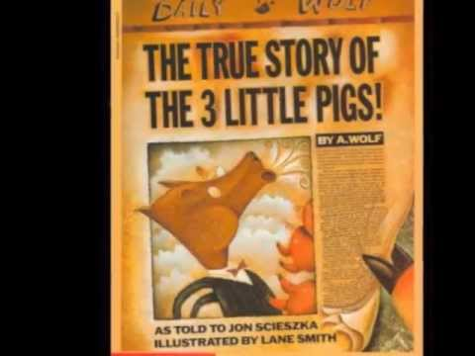

Slide 3
The original story
Both
The “true” story

Slide 4
Consider these questions:
Who is telling the story and how is it a different point of view from the original?
How do these things change? Be specific.
The plot?
Your feelings for the pigs?
Your feelings for the wolf?
The theme of the story?

Slide 5
Point of View
When studying the perspective of the narrator, the reader is concerned with the relationship between the person telling the story (the narrator) and the agents referred to by the story teller (the characters).

Slide 6
The three main types of point of view
First (1st)
The narrator is the main character, or protagonist. They will use the pronouns I, me, my, myself, we, us when describing events.
Second (2nd)
In these stories you are the narrator of this story. This is a very rare style of narration. Choose your own adventure novels are written this way, you make the decision of what happens.
Third (3rd)
With this mode of narration, the narrator tells the story of another person or group of people. The narrator may be far removed from or not involved in the story, or he or she may be a supporting character supplying narration for a hero. Third Person narration will have frequent use of “he, she, them, they, him, her, his, her, and their.”

Slide 7
Third Person POV is split into three distinct categories
Objective
In this mode of narration, the narrator tells a third-person’s story (he, she, him, her), but the narrator only describes characters’ behavior and dialogue. The narrator does not reveal any character’s thoughts or feelings.
Limited
The narrator’s perspective is limited to the internal workings of one character. In other words, the narrator reveals the thoughts and feelings of one character through explicit narration.
Omniscient
In this mode of narration, the narrator grants readers the most access to characters’ thoughts and feelings. With third-person omniscient narration, the narration will reveal more than one characters’ internal workings. The base word omni means “all,” and scient means “knowing,” so omniscient roughly translates to “all knowing.”

Slide 8
Let’s review our novels
Dracula by Bram Stoker
Dracula has several first person narrations from different characters including journals and diary entries.
Great Expectations by Charles Dickens
Pip is a first person narrator in this story so we see everything from his point of view.
Pride & Prejudice by Jane Austen
This novel is written in third-person omniscient so the narrator knows all the thoughts and feelings of all characters.
The Strange Case of Dr. Jekyll and Mr. Hyde by Robert Louis Stevenson
The narrator is anonymous and speaks in the third person. Dr. Lanyon and Dr. Jekyll each narrate one chapter of the novel via a letter. For most of the novel, the narrative follows Utterson’s point of view; in the last two chapters, Lanyon and Jekyll report their experiences from their own perspectives.
The Picture of Dorian Gray by Oscar Wilde
The point of view is third person, omniscient. The narrator chronicles both the external and internal worlds of the characters. In one paragraph Oscar Wilde becomes the first-person narrator.
Frankenstein by Mary Shelley
The point of view shifts with the narration, from Robert Walton to Victor Frankenstein to Frankenstein’s monster, then back to Walton, with a few digressions in the form of letters from Elizabeth Lavenza and Alphonse Frankenstein, however, almost all of these are in first person.

Slide 9
Read and examine point of view/narration in the Oliver Twist excerpt. Open to page 941 in the textbook.
2
Notes:
As you are reading through Oliver Twist with your class, point out imagery, figurative language, and of course point of view. From Sparknotes: The narrator is third person omniscient, and assumes the points of view of various characters in turn. The narrator’s tone is not objective; it is sympathetic to the protagonists and far less so to the novel’s other characters. When dealing with hypocritical or morally objectionable characters, the narrative voice is often ironic or sarcastic.

Slide 10
Next class you will write an Interpretive Response about Narration (POV). You may use your notes to help you write the response which must be a page in length!! Bring your notes to class on Wednesday.
IMPORTANT
INFORMATION

Slide 11
Literature Circle Meeting
Each person should share what they recorded on their role sheet.
As each person shares, record notes in the space provided on the back of your role sheet.
Before you conclude, make sure everyone in the group knows what pages to read by next class, and is assigned a new role.
Get your new role sheet. (Role #4)
Role sheet #4 and reading will be due on Friday, 1/20/17.

Slide 12
READ! SILENTLY!

